Slide 1
Using Principle Component Analysis to Rank and Scout NBA Players
By: Jackson Bronkema

Slide 2
Objectives
Why this topic?
What is PCA?
How do we perform PCA?
Case Analysis
Using PCA to choose draft prospects
Performing SDI on our PCA to find economical free agents
Rank All-Time great NBA Players
Areas for Further Research

Slide 3
Why Did I Choose This Topic?
Passionate about Business Analytics
Interested in Business Side of Professional Sports
Big NBA Fan
Answer the question: ”Who is the greatest basketball player ever?”

Slide 4
What is PCA?
Data Analysis technique created in 1901 by Karl Pearson
Developed and named by Harold Hotelling in the 1930s
Technique that reduces the dimensionality of data sets
Retains most the variation in the data set
Minimizes information loss
Notes:
Time tested process

Slide 5
What is PCA?
PCA can be obtained from taking the SVD of mean-centered covariance matrix
Statistical Interpretation of SVD
Goal of PCA:
Reduce the dimensionality of the matrix
Trade as little accuracy as possible
Better understand our data set to make informed decisions
Assign a single number value to players

Slide 6
How to Perform PCA on a Data Set?
4 Main Steps
Standardize the data
Put our data into matrix form
Normalize the data by putting it into mean deviation form
Calculate the covariance matrix of the standardized matrix
Compute the eigenvalues and eigenvectors of the covariance matrix

Slide 7
How to Perform PCA on a Data Set?
4. Multiply the standardized matrix by the PCs to obtain a numerical representation of each subject
Eigenvalues are amount of variation represented by each PC
Eigenvectors represent PCs
PCs help us find variation in amongst observation vectors
Help us rank players
Principle Components: new variables constructed as linear combinations of mixtures of the initial variables

Slide 8

Case Analysis: Using PCA in Scouting Prospects
Timberwolves have the #1 Pick in the 2020 NBA draft
Team Needs: 1 Guard and 1 Forward
Use PCA to inform our decision on which players the team should draft and sign in free agency.

Slide 9
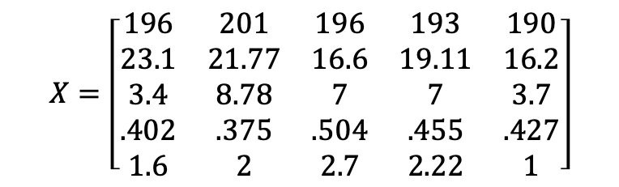
Draft Prospects
 | Edwards | Ball | Haliburton | Hayes | Maxey
Height (cm) | 196 | 201 | 196 | 193 | 190
PP 40 min | 23.1 | 21.78 | 16.6 | 19.11 | 16.2
AP 40 min | 3.4 | 8.78 | 7 | 7 | 3.7
FG% | 0.402 | 0.375 | 0.504 | 0.455 | 0.427
SP 40 min | 1.6 | 2 | 2.7 | 2.22 | 1
We will look at the top 5 guards
Anthony Edwards
Lamelo Ball
Tyrese Haliburton
Killian Hayes
Tyrese Maxey
5 main statistics we are looking for
Height (cm)
Points per 40 min
Assists per 40 min
FG %
Steals per 40 min
$$X=\left[\begin{matrix}196 & 201 & 196 & 193 & 190 \\ 23.1 & 21.77 & 16.6 & 19.11 & 16.2 \\ 3.4 & 8.78 & 7 & 7 & 3.7 \\ .402 & .375 & .504 & .455 & .427 \\ 1.6 & 2 & 2.7 & 2.22 & 1\end{matrix}\right]$$

Slide 10
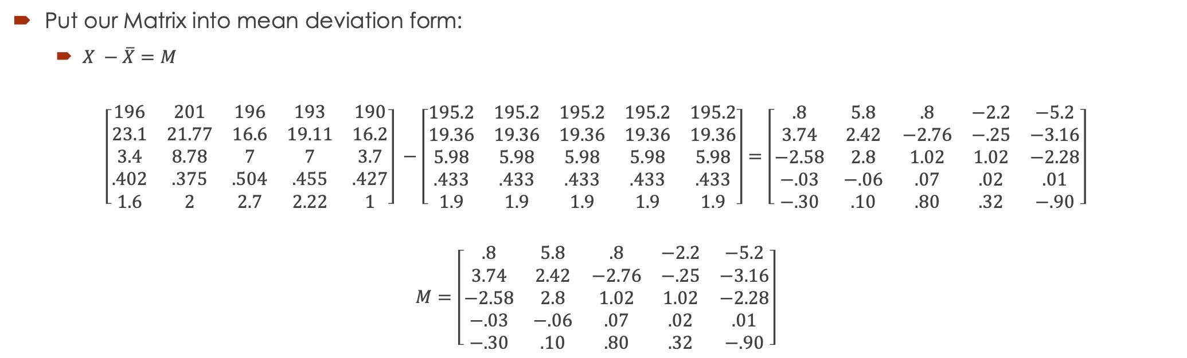
Standardize the Data
Put our Matrix into mean deviation form:
$X −\overline{X}=M$
$$\left[\begin{matrix}196 & 201 & 196 & 193 & 190 \\ 23.1 & 21.77 & 16.6 & 19.11 & 16.2 \\ 3.4 & 8.78 & 7 & 7 & 3.7 \\ .402 & .375 & .504 & .455 & .427 \\ 1.6 & 2 & 2.7 & 2.22 & 1\end{matrix}\right] −\left[\begin{matrix}195.2 & 195.2 & 195.2 & 195.2 & 195.2 \\ 19.36 & 19.36 & 19.36 & 19.36 & 19.36 \\ 5.98 & 5.98 & 5.98 & 5.98 & 5.98 \\ .433 & .433 & .433 & .433 & .433 \\ 1.9 & 1.9 & 1.9 & 1.9 & 1.9\end{matrix}\right]=\left[\begin{matrix}.8 & 5.8 & .8 & −2.2 & −5.2 \\ 3.74 & 2.42 & −2.76 & −.25 & −3.16 \\ −2.58 & 2.8 & 1.02 & 1.02 & −2.28 \\ −.03 & −.06 & .07 & .02 & .01 \\ −.30 & .10 & .80 & .32 & −.90\end{matrix}\right]$$
$$M=\left[\begin{matrix}.8 & 5.8 & .8 & −2.2 & −5.2 \\ 3.74 & 2.42 & −2.76 & −.25 & −3.16 \\ −2.58 & 2.8 & 1.02 & 1.02 & −2.28 \\ −.03 & −.06 & .07 & .02 & .01 \\ −.30 & .10 & .80 & .32 & −.90\end{matrix}\right]$$

Slide 11
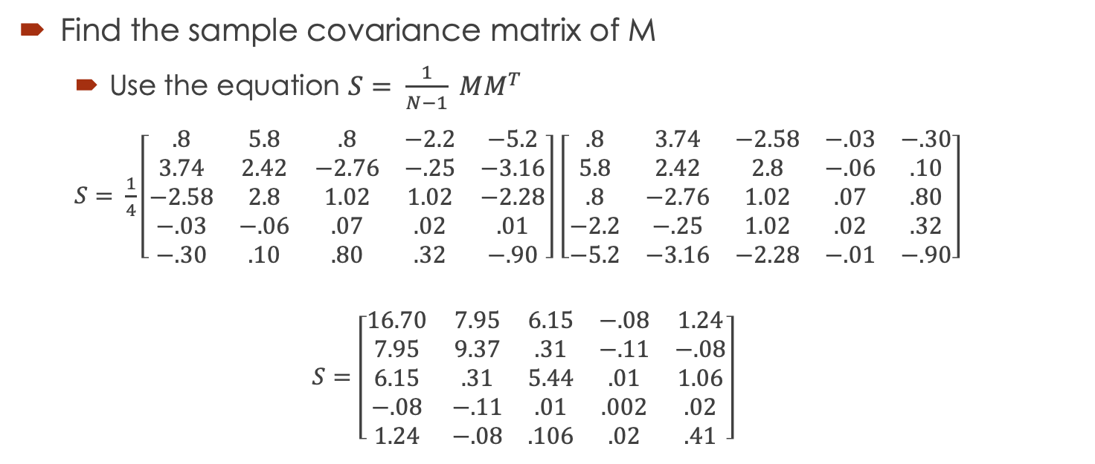
Calculate the Sample Covariance Matrix
Find the sample covariance matrix of M
Use the equation $S= \frac{1}{N−1} MM^{T}$
$S= \frac{1}{4}\left[\begin{matrix}.8 & 5.8 & .8 & −2.2 & −5.2 \\ 3.74 & 2.42 & −2.76 & −.25 & −3.16 \\ −2.58 & 2.8 & 1.02 & 1.02 & −2.28 \\ −.03 & −.06 & .07 & .02 & .01 \\ −.30 & .10 & .80 & .32 & −.90\end{matrix}\right]$ $\left[\begin{matrix}.8 & 3.74 & −2.58 & −.03 & −.30 \\ 5.8 & 2.42 & 2.8 & −.06 & .10 \\ .8 & −2.76 & 1.02 & .07 & .80 \\ −2.2 & −.25 & 1.02 & .02 & .32 \\ −5.2 & −3.16 & −2.28 & −.01 & −.90\end{matrix}\right]$
$$S=\left[\begin{matrix}16.70 & 7.95 & 6.15 & −.08 & 1.24 \\ 7.95 & 9.37 & .31 & −.11 & −.08 \\ 6.15 & .31 & 5.44 & .01 & 1.06 \\ −.08 & −.11 & .01 & .002 & .02 \\ 1.24 & −.08 & .106 & .02 & .41\end{matrix}\right]$$

Slide 12
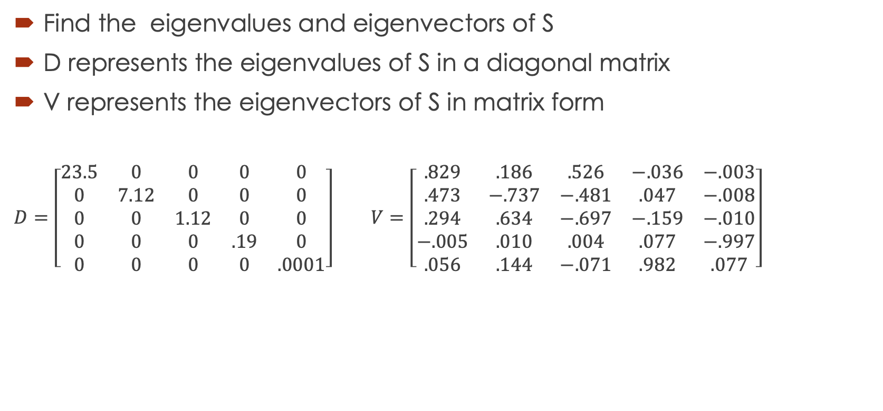
Find Eigenvalues and Eigenvectors
Find the eigenvalues and eigenvectors of S
D represents the eigenvalues of S in a diagonal matrix
V represents the eigenvectors of S in matrix form
$D=$ $\left[\begin{matrix}23.5 & 0 & 0 & 0 & 0 \\ 0 & 7.12 & 0 & 0 & 0 \\ 0 & 0 & 1.12 & 0 & 0 \\ 0 & 0 & 0 & .19 & 0 \\ 0 & 0 & 0 & 0 & .0001\end{matrix}\right]$ $V=\left[\begin{matrix}.829 & .186 & .526 & −.036 & −.003 \\ .473 & −.737 & −.481 & .047 & −.008 \\ .294 & .634 & −.697 & −.159 & −.010 \\ −.005 & .010 & .004 & .077 & −.997 \\ .056 & .144 & −.071 & .982 & .077\end{matrix}\right]$

Slide 13
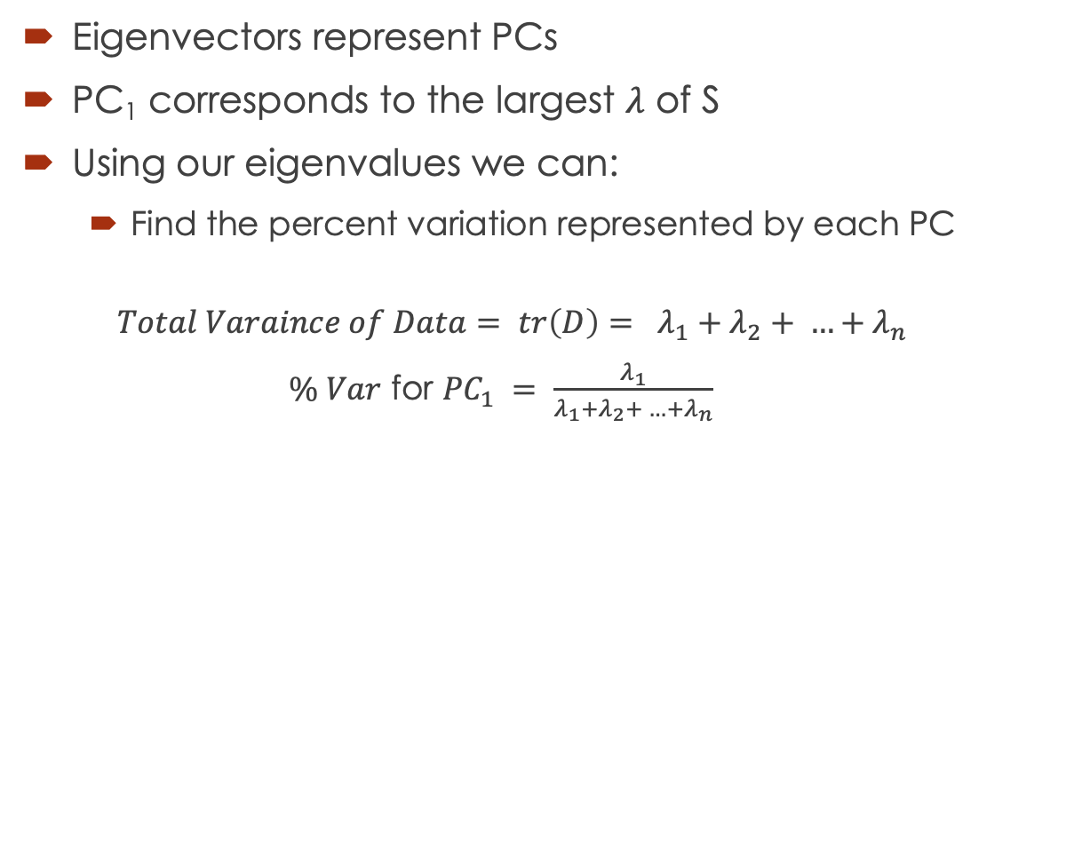
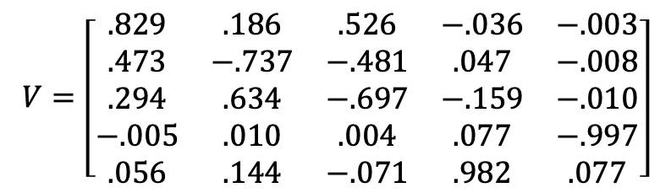
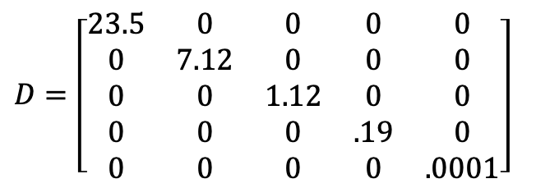
$D=$ $\left[\begin{matrix}23.5 & 0 & 0 & 0 & 0 \\ 0 & 7.12 & 0 & 0 & 0 \\ 0 & 0 & 1.12 & 0 & 0 \\ 0 & 0 & 0 & .19 & 0 \\ 0 & 0 & 0 & 0 & .0001\end{matrix}\right]$
$$V=\left[\begin{matrix}.829 & .186 & .526 & −.036 & −.003 \\ .473 & −.737 & −.481 & .047 & −.008 \\ .294 & .634 & −.697 & −.159 & −.010 \\ −.005 & .010 & .004 & .077 & −.997 \\ .056 & .144 & −.071 & .982 & .077\end{matrix}\right]$$
Eigenvectors represent PCs
PC₁ corresponds to the largest $λ$ of S
Using our eigenvalues we can:
Find the percent variation represented by each PC
$$Total Varaince of Data= tr\left(D\right)= λ_{1}+λ_{2}+ …+λ_{n}$$
$\% Var$ for ${PC}_{1} = \frac{λ_{1}}{λ_{1}+λ_{2}+ …+λ_{n}}$
Principle Component | 1 | 2 | 3 | 4 | 5
Eigenvalue | 23.5 | 7.12 | 1.12 | .19 | .001
Total Variability | 73.6% | 22.3% | 3.5% | .6% | .00003%

Slide 15
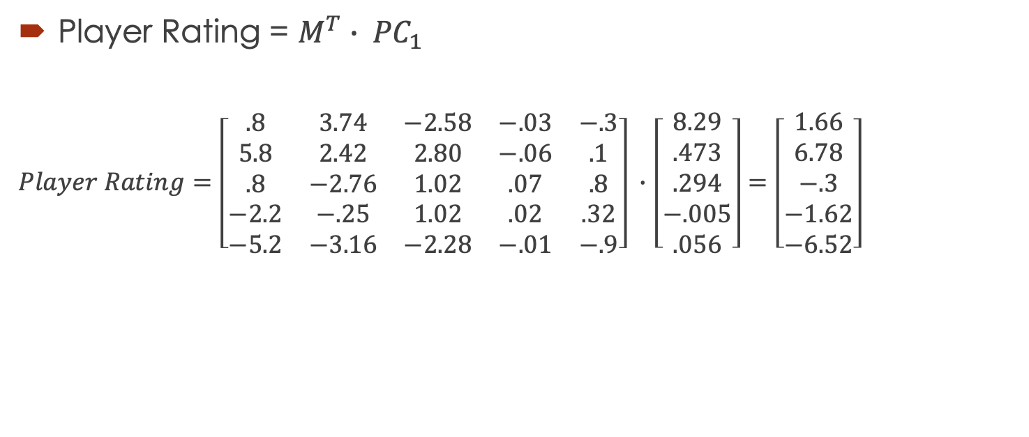
Using PC₁ to Rank Prospects
Player Rating = $M^{T}∙ {PC}_{1}$
$Player Rating=\left[\begin{matrix}.8 & 3.74 & −2.58 & −.03 & −.3 \\ 5.8 & 2.42 & 2.80 & −.06 & .1 \\ .8 & −2.76 & 1.02 & .07 & .8 \\ −2.2 & −.25 & 1.02 & .02 & .32 \\ −5.2 & −3.16 & −2.28 & −.01 & −.9\end{matrix}\right] ∙$ $\left[\begin{matrix}8.29 \\ .473 \\ .294 \\ −.005 \\ .056\end{matrix}\right]=\left[\begin{matrix}1.66 \\ 6.78 \\ −.3 \\ −1.62 \\ −6.52\end{matrix}\right]$
Player | PC₁ Score | Rank
Ball | 6.78 | 1
Edwards | 1.66 | 2
Haliburton | -.3 | 3
Hayes | -1.62 | 4
Maxey | -6.52 | 5

Slide 16
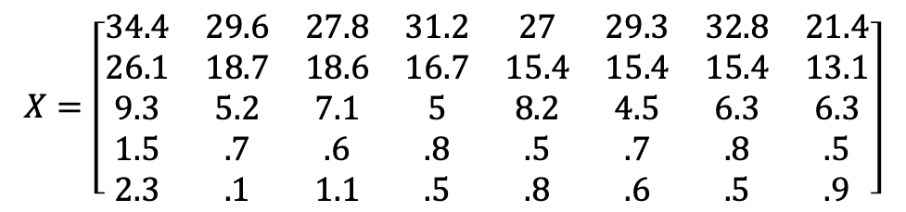
Free Agency
Want to Select a Forward
We will use PCA to rank the top 8 Free Agent Forwards
Use 5 statistics to help us make our decision
 | Anthony Davis | Danilo Gallinari | Montrezl Harrell | Marcus Morris Sr. | Serge Ibaka | Davis Bertans | Carmelo Anthony | Christian Wood
MPG | 34.4 | 29.6 | 27.8 | 31.2 | 27 | 29.3 | 32.8 | 21.4
PPG | 26.1 | 18.7 | 18.6 | 16.7 | 15.4 | 15.4 | 15.4 | 13.1
RPG | 9.3 | 5.2 | 7.1 | 5 | 8.2 | 4.5 | 6.3 | 6.3
SPG | 1.5 | 0.7 | 0.6 | 0.8 | 0.5 | 0.7 | 0.8 | 0.5
BPG | 2.3 | 0.1 | 1.1 | 0.5 | 0.8 | 0.6 | 0.5 | 0.9
$$X=\left[\begin{matrix}34.4 & 29.6 & 27.8 & 31.2 & 27 & 29.3 & 32.8 & 21.4 \\ 26.1 & 18.7 & 18.6 & 16.7 & 15.4 & 15.4 & 15.4 & 13.1 \\ 9.3 & 5.2 & 7.1 & 5 & 8.2 & 4.5 & 6.3 & 6.3 \\ 1.5 & .7 & .6 & .8 & .5 & .7 & .8 & .5 \\ 2.3 & .1 & 1.1 & .5 & .8 & .6 & .5 & .9\end{matrix}\right]$$

Slide 17
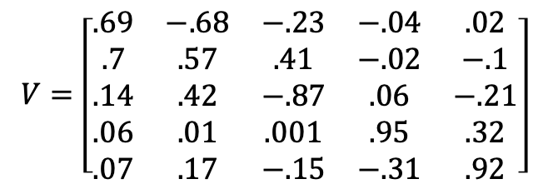
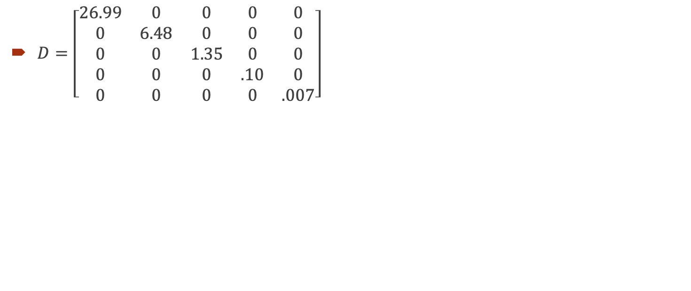
$D=\left[\begin{matrix}26.99 & 0 & 0 & 0 & 0 \\ 0 & 6.48 & 0 & 0 & 0 \\ 0 & 0 & 1.35 & 0 & 0 \\ 0 & 0 & 0 & .10 & 0 \\ 0 & 0 & 0 & 0 & .007\end{matrix}\right]$
$$V=\left[\begin{matrix}.69 & −.68 & −.23 & −.04 & .02 \\ .7 & .57 & .41 & −.02 & −.1 \\ .14 & .42 & −.87 & .06 & −.21 \\ .06 & .01 & .001 & .95 & .32 \\ .07 & .17 & −.15 & −.31 & .92\end{matrix}\right]$$
Principle Component | 1 | 2 | 3 | 4 | 5
Eigenvalue | 26.99 | 6.48 | 1.35 | .1 | .007
Total Variability | 77.3% | 18.5% | 3.9% | .003% | .0002%

Slide 18
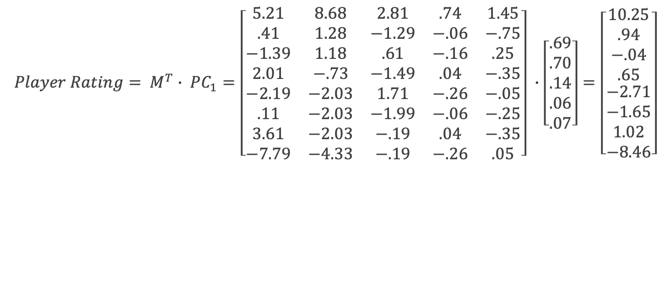
Using PC₁ to Rank Free Agents
$$Player Rating= M^{T}∙ {PC}_{1}=\left[\begin{matrix}5.21 & 8.68 & 2.81 & .74 & 1.45 \\ .41 & 1.28 & −1.29 & −.06 & −.75 \\ −1.39 & 1.18 & .61 & −.16 & .25 \\ 2.01 & −.73 & −1.49 & .04 & −.35 \\ −2.19 & −2.03 & 1.71 & −.26 & −.05 \\ .11 & −2.03 & −1.99 & −.06 & −.25 \\ 3.61 & −2.03 & −.19 & .04 & −.35 \\ −7.79 & −4.33 & −.19 & −.26 & .05\end{matrix}\right] ∙\left[\begin{matrix}.69 \\ .70 \\ .14 \\ .06 \\ .07\end{matrix}\right]=\left[\begin{matrix}\begin{aligned}10.25 \\ .94 \\ −.04 \\ .65\end{aligned} \\ −2.71 \\ −1.65 \\ 1.02 \\ −8.46\end{matrix}\right]$$
Player | PC₁ Score | Rank
Anthony Davis | 10.25 | 1
Carmelo Anthony | 1.02 | 2
Danilo Gallinari | .94 | 3
Marcus Morris Sr. | .65 | 4
Montrezl Harrell | -.04 | 5
Davis Bertrans | -1.65 | 6
Serge Ibaka | -2.71 | 7
Christian Wood | -8.46 | 8

Slide 19
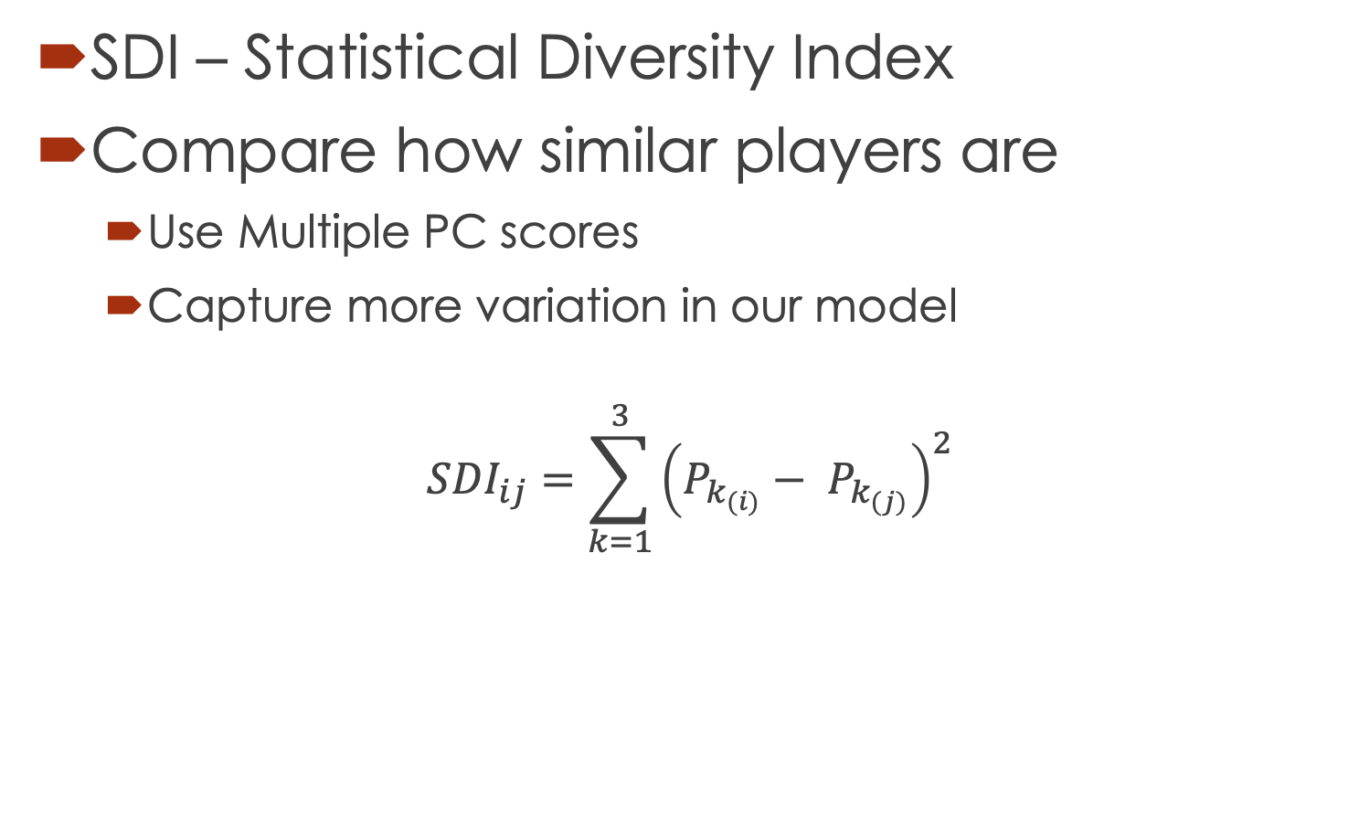
Comparing Pairwise Players Using SDI
SDI – Statistical Diversity Index
Compare how similar players are
Use Multiple PC scores
Capture more variation in our model
$${SDI}_{ij}=\sum_{k=1}^{3}{{\left(P_{k_{(i)}}− P_{k_{(j)}}\right)}^{2}}$$

Slide 20
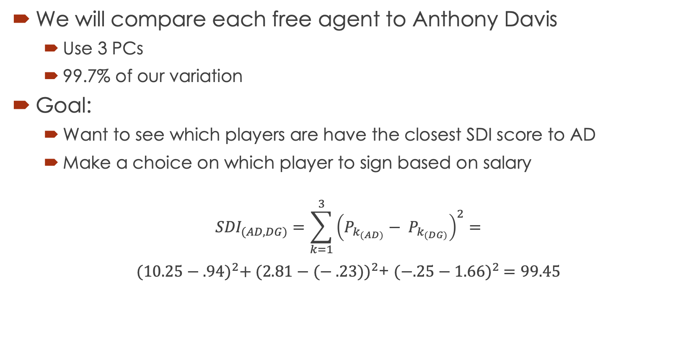
Comparing Pairwise Players Using SDI
We will compare each free agent to Anthony Davis
Use 3 PCs
99.7% of our variation
Goal:
Want to see which players are have the closest SDI score to AD
Make a choice on which player to sign based on salary
$${SDI}_{(AD, DG)}=\sum_{k=1}^{3}{{\left(P_{k_{(AD)}}− P_{k_{(DG)}}\right)}^{2}}=$$
${(10.25−.94)}^{2}+ {(2.81−(− .23))}^{2}$+ ${(−.25−1.66)}^{2} =99.45$

Slide 21
Comparing Pairwise Players Using SDI
Player | SDI | Salary
Danilo Gallinari | 99.4 | $21,587,759
Montrezl Harrell | 106.7 | $6,000,000
Marcus Morris Sr. | 120.8 | $15,000,000
Carmelo Anthony | 129.7 | $2,159,059
Davis Bertans | 167.1 | $7,250,000
Serge Ibaka | 173.4 | $21,666,667
Christian Wood | 349.9 | $1,578,979
Pursue Montrezl Harrel
Similar PC₁ Score and SDI to Anthony Davis
Affordable Option

Slide 22
Ranking Top NBA Players of All-Time
Ranked 50 Best Players of All-Time
32 Different Statistics Used
Team Accomplishments
Individual Awards
Individual Stats
Analytical Stats
PCA and Massey Method
Massey Method to create own ranking
Use a vector representing weights to rank players
More Subjective than PCA

Slide 23
Comparing the Rankings
PCA Top 10
Rank | Name | Score
1 | Bill Russell | 11.86
2 | Michael Jordan | 7.79
3 | Kareem Abdul-Jabbar | 7.07
4 | Lebron James | 6.67
5 | John Havlicek | 6.11
6 | Tim Duncan | 5.64
7 | Kobe Bryant | 4.46
8 | Magic Johnson | 4.41
9 | Shaquille O’Neal | 3.87
10 | Bob Cousy | 2.72
Massey Method Top 10
Rank | Name | Score
1 | Kareem Abdul-Jabbar | 73.6
2 | Lebron James | 71.41
3 | Bill Russell | 71.40
4 | Michael Jordan | 70.95
5 | Tim Duncan | 64.5
6 | Wilt Chamberlain | 59.4
7 | Kobe Bryant | 59.1
8 | John Havlicek | 56.9
9 | Shaquille O’Neal | 56.8
10 | Magic Johnson | 54.2

Slide 24
PCA vs Massey Method

Slide 25
Areas For Further Research
Non-linear dimensionality reduction techniques
Kernel PCA
Applications to Stock Market Portfolios
Using different technologies to ease in data manipulation and visualization
R
Python
SQL
New methods for ranking athletes
Colley Method
Predictive Models to help inform decisisons

Slide 26
References
Alamar, Ben. Sports Analytics: a Guide for Coaches, Managers, and Other Decision Makers. Columbia University Press, 2013.
Chartier, Timothy P. When Life Is Linear: from Computer Graphics to Bracketology. The Mathematical Association of America., 2015.
Colley, Wesley N. Colley’s Bias Free College Football Ranking Method: Colley’s Bias Free College Football Ranking Method:
ESPN, ESPN Internet Ventures, www.espn.com/nba/history/leaders.
“Sports Analytics.” Index Page, apbr.org/forum/.
“NBA & ABA Leaders and Records.” Basketball, www.basketball-reference.com/leaders/.
“Top 50 NBA Players of All Time in NBA History (Updated List).” Sports Articles, 17 July 2020, www.lineups.com/articles/top-50-nba-players-all-time/.
The Emergence of Sport Analytics. (2016, May 18). Retrieved October 31, 2020, from http://analytics- magazine.org/the-emergence-of-sport-analytics/
Lay, D. C. (2006). Linear algebra and it's applications. Boston: Pearson, Addison-Wesley.
Steinberg, L. (2015, August 18). CHANGING THE GAME: The Rise of Sports Analytics. Retrieved October 31, 2020, from https://www.forbes.com/sites/leighsteinberg/2015/08/18/changing-the-game- the-rise-of-sports-analytics/?sh=3ee02da24c1f

Slide 27
Questions?

